Slide 1
Unsupervised Learning

Slide 2
Definition
Unsupervised Learning is a type of machine learning where the model works without labelled data. It learns patterns on its own by grouping similar data points or finding hidden structures without any human intervention.
It is used for tasks like clustering, dimensionality reduction and Association Rule Learning.
Helps identify hidden patterns in data
Useful for grouping, compression and anomaly detection

Slide 3
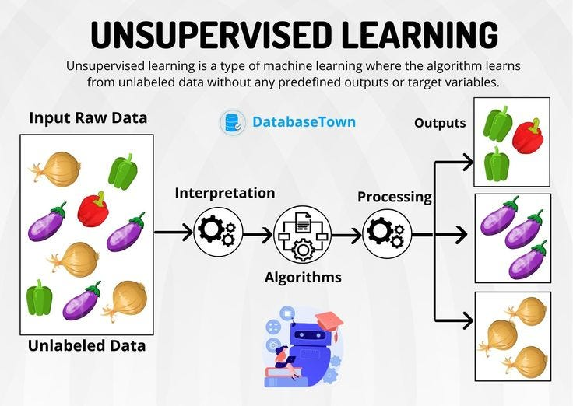

Slide 4
PCA (Principal Component Analysis)
PCA (Principal Component Analysis) is a dimensionality reduction technique and helps us to reduce the number of features in a dataset while keeping the most important information. It changes complex datasets by transforming correlated features into a smaller set of uncorrelated components.

Slide 5
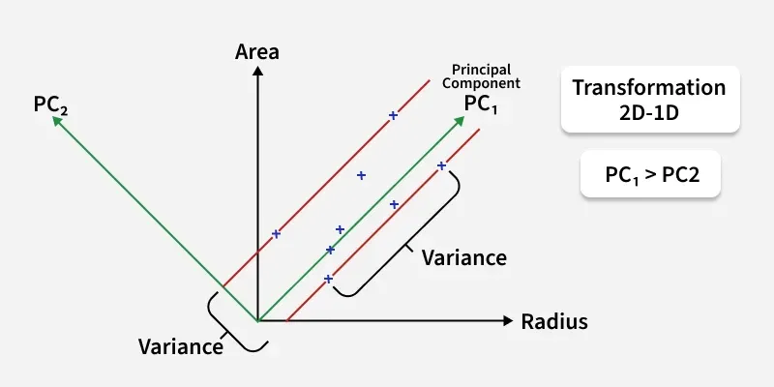
PCA Geometry

Slide 6
K-Means
K-Means Clustering groups similar data points into clusters without needing labeled data. It is used to uncover hidden patterns when the goal is to organize data based on similarity.

Slide 7
